Slide 1
Continuous Delivery Overall Workflow and QA Steps
Senthil Desappan
12/05/2019

Slide 2
What is Continuous Delivery?
Continuous Delivery is a way of delivering components, products, or piece of software independently and in short cycles. Compared to the classical release pipeline, its main differentiators are to include fewer stages from development to production, and to allow for services with independent life cycles.
Continuous Delivery enables one to declare, develop, build, deploy, test, push to production, and operate services using a Git repository.
Continuous Delivery uses software pipelines made up of linked stages, usually a set of development stages, an integration stage, and a production stage.

Slide 3
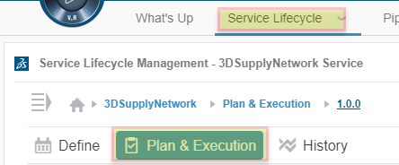
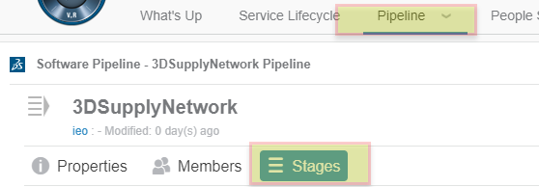
Continuous Delivery Tool
Continuous Delivery tool is a Dashboard in our platform with four tabs. Service Lifecycle and the Pipeline tabs are mainly used to do our work
Service Lifecycle Management (SLM) is dedicated to help create Service Versions, manage their content in terms of DSxR&D requirements and incident reports.
Pipeline is a connected set of stages to automate continuous delivery of a service.
It executes and automates all steps and operations necessary to deliver software modifications identified by work items.
Plan & Execution tab provides details of ER’s, Function’s, related Tasks and IR’s which are linked to the Service Version object.
A stage is a working environment to serve Continuous Delivery activities required to manage changes on a component or service from development to production.
Three kinds of stages exist: development, integration, and production.
QA stage is a type of development stage and pulls the code from integration stage (explained in later slides)

Slide 4

Overall Workflow Diagram
DEV Stage
3DSupplyNetwork_1.0.0_ABC
Owner: Developer
Each Dev continuously commits the code to Integration stage
DEV Stage
3DSupplyNetwork_1.0.0_XYZ
Owner: Developer
Integration stage will have the latest and greatest code. Owner of the stage will process the CR and runs the robot.
DEV Stage
3DSupplyNetwork_1.0.0_ABC
Owner: Developer
INTEGRATION Stage
3DSupplyNetwork_1.0.0
Owner: Dev Lead / Release Manager
QA Stage
3DSupplyNetwork_1.0.0_QA
Owner: QA
QA Stage will be a replica of Integration stage. This dedicated stage will provide more control and flexibility for QA team to test.
N-1 Reference Stage
3DSupplyNetwork_1.0.0_ Sprint x Owner: DEV Lead
This stage will be built at the end of each sprint providing the reference stack of previous sprint.

Slide 5
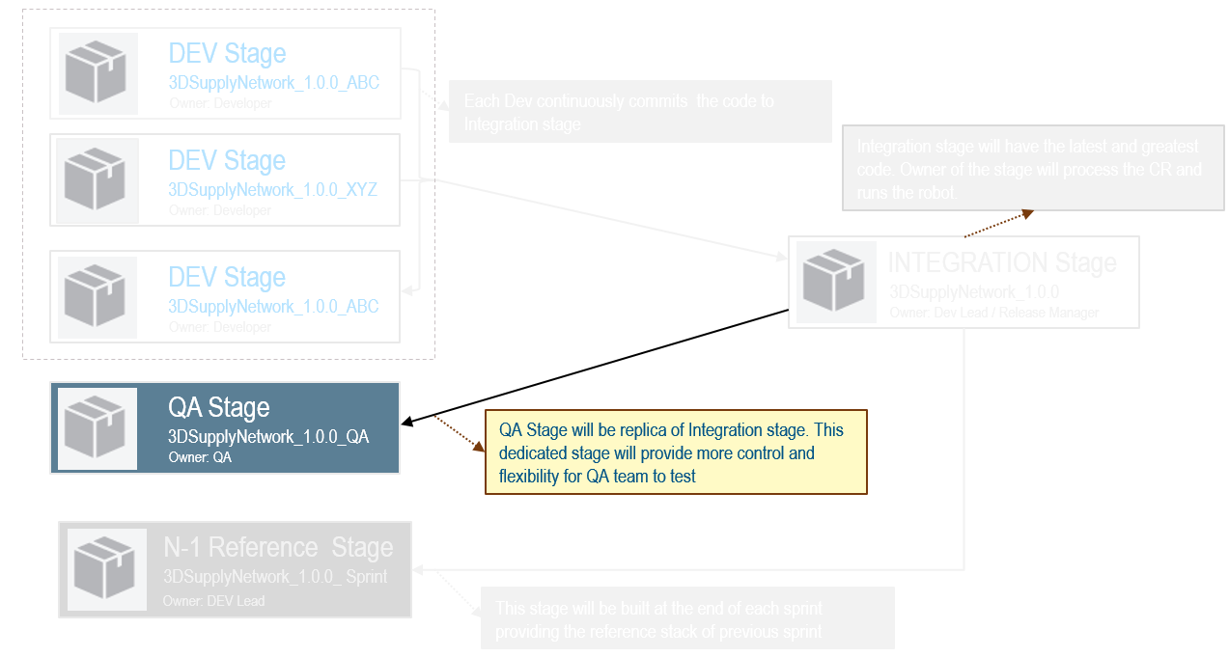
QA Workflow
1
4
Plan & Execution
QA Stage
3DSupplyNetwork_1.0.0_QA
Owner: QA
In DSxDEV, Functions and Tasks to be created by DEV
Create QA task in above Function and that task will be used for code refresh
All these functions and tasks will be listed in this ‘Plan & Execution’ tab
Create a new Change Request using the QA task
Select the Change request as active
In Factory tab, select the Change request and Execute the robot
Launch Sandbox once the Robot completes
2
3
DEV Stage
3DSupplyNetwork_1.0.0_ABC
Owner: Developer
INTEGRATION Stage
3DSupplyNetwork_1.0.0
Owner: Dev Lead / Release Manager
QA team member to be added as members for DEV stages
Change Request tab and the Factory tab provides info on which tasks are promoted to Integration stage those which are in-work
Pending - Change Requests that are pushed up from Dev stage but not yet integrated
Processing - Change Requests that are deployed in Integrated stage

Slide 6
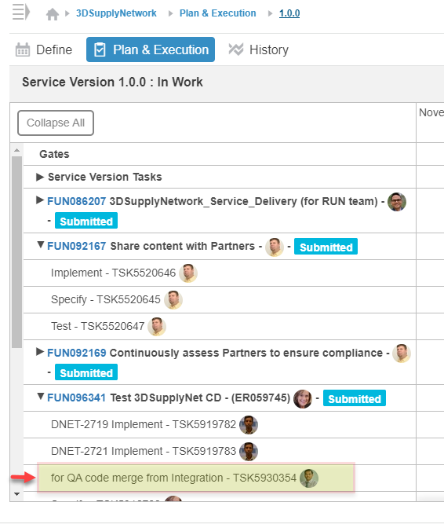
1. Planning & Execution – Functions and Tasks
Ensure all functions and tasks related to current sprint are listed in the “Plan & Execution” tab
If you using JIRA, then for each story there should be corresponding tasks in DSxDEV
DEV will use this task to promote the code through pipeline and QA will know what is promoted using task ID
Create a new task which will be used to retrieve the code from Integration to QA stage

Slide 7
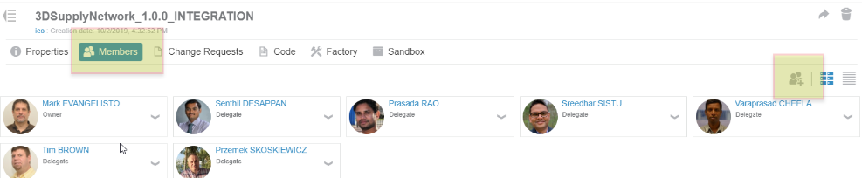
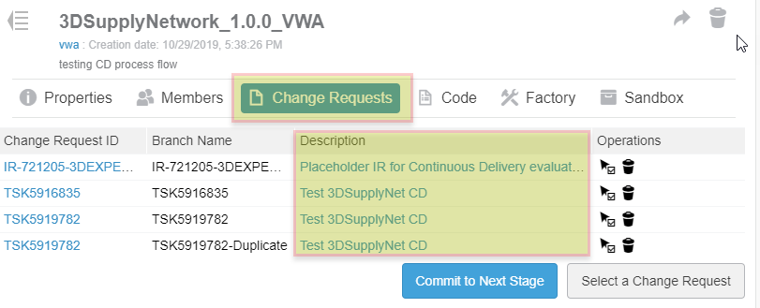
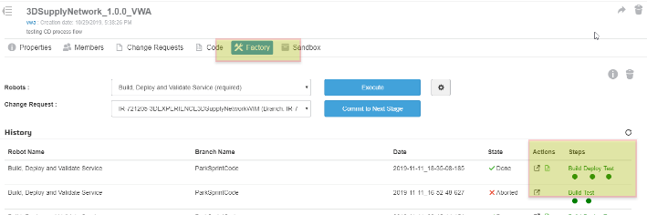
2. Access to DEV stages
This is not mandatory but good to have - check if QA team has access to all DEV stages.
For each DEV stage, from Change Requests tab you can check and understand which story/tasks are promoted. Description column may provide more detail.
Factory tab provides info on which change requests are deployed and pushed to Integration stage.

Slide 8
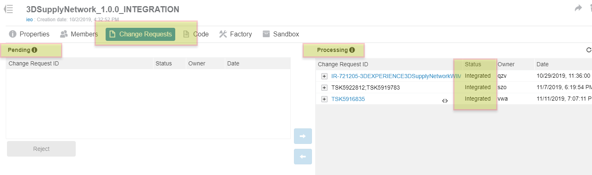
3. Integration Stage
Change Requests tab of this stage has two sections. Pending and Processing.
Pending - Change Requests in the sections are those pushed up from Dev stage but not yet integrated
Processing - Change Requests in this section (with status as integrated) are those which are deployed in Integrated stage

Slide 9
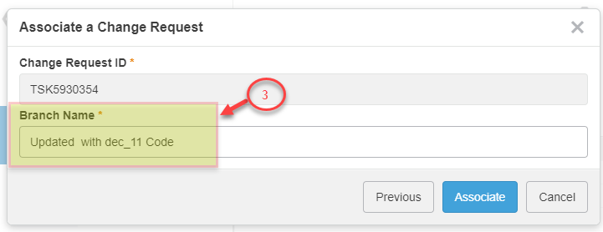
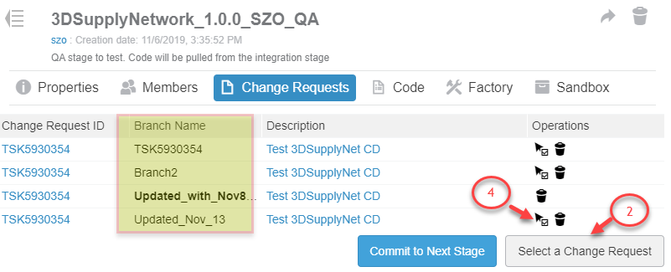
4. QA Stage & Validations (1/2)
QA builds this env based on the status in Integration stage and does the testing from this sandbox.
Following are the steps to be followed by QA responsible to pull the latest code
Check the status of the Integration stage and ensure the status of the factory is green and the quick test on the sandbox in that stage is OK
In the change request tab, click “Select a change request”, select the QA task which was created in slide 5.
Complete the creation of change request by providing a branch name. Enter the name similar to “Updated_with_dec_11 code” for easy identification.
Make sure to mark newly created Change Request as Active if not already.
A DEV stage branch is always created from the INT stage branch
Notes:
Need to update with info on frequency of this refresh

Slide 10
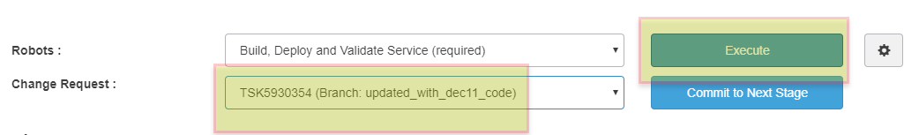
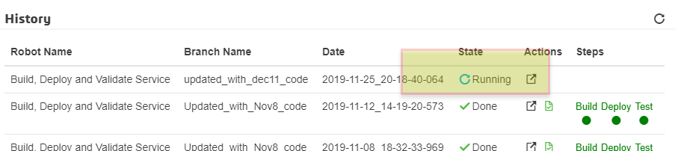
4. QA Stage & Validations (2/2)
Go to Factory tab ensure the correct Change Request is selected in the drop down and Click Execute
Robot will run and when completes three green dot’s will show up for Build, Deploy and Test. This may take up to 2 hours
Once the Robot completes, go to the Sandbox tab and launch the sandbox testing env
Do not click “Commit to Next Stage” in QA stage. This will push the code from QA to Integration stage which should not happen.
Notes:
Need to update with info on frequency of this refresh

Slide 11
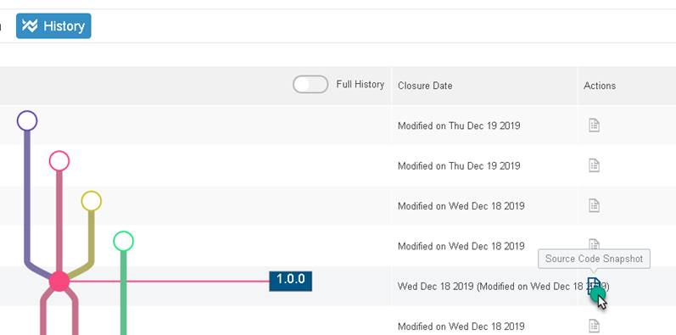
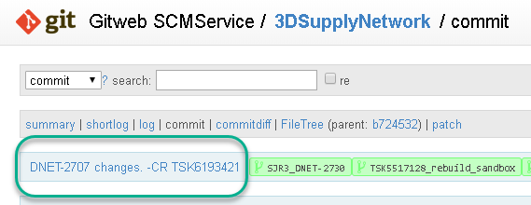
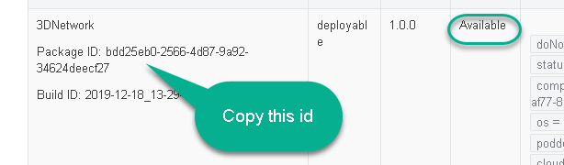
5. QA Stage – Sandbox with Previous Package id
Alternatively a sandbox of QA Stage can also be created using Package ID of Integration stage. This can save considerable amount of time as the complete Build, Deploy and Test steps are not needed to run again.
Following are the steps to achieve the same
Find Package ID
Navigate to the service History
Identify the specific change, based on the timeline plus Source Code history
Notes:
Need to update with info on frequency of this refresh

Slide 12
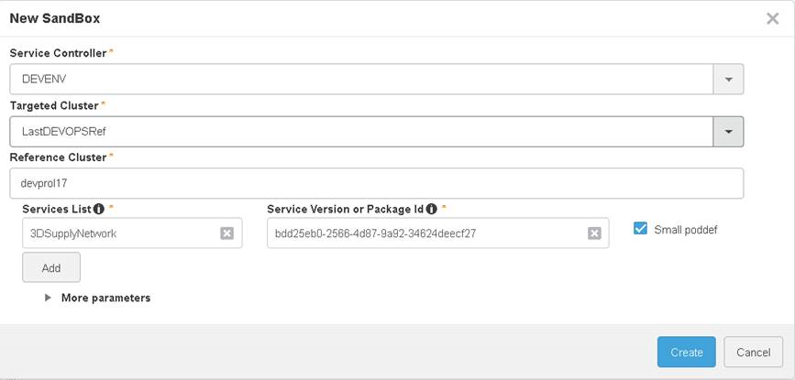
5. QA Stage – Sandbox with Previous Package id
Creating the sandbox
Navigate to the QA DEV stage and click plus (+) icon to add a new sandbox
Choose the service (3DSupplyNetwork) and enter the Package ID from the previous slide. Click Create.
This will delete any existing sandbox and create a new sandbox.
Notes:
Need to update with info on frequency of this refresh

Slide 13
References
WW Ops documentation for QA process in Continuous Delivery
https://eu1-215dsi0708-ifwe.3dexperience.3ds.com/#app:MAP-EVLNUOYNA/content:type=document&PNid=7282558
DSDOC for Continuous Delivery
https://dsxdev-online.dsone.3ds.com/doconline/DSInternalExaDoc.htm?show=ProDsxDevDVO/opstc0000.htm
Swym community “3DEXPERIENCE Service Continuous Delivery
https://dsext001-eu1-215dsi0708-3dswym.3dexperience.3ds.com/#community:3TrdH6GpRv2cX6a-dV701g

Slide 15
Continuous Delivery Workflow
To be added
Code Review process
ODT, adding QA test cases
Iterations
Merge Conflicts
SERVICE LIFECYCLE
Creation and availability of new Service Version
In DSxDEV, Link the Service, Program, Project. Add Functions to the Project
In DSxDEV, Under the Function create Tasks for each JIRA Story and for Story Bug.
OLD
PIPELINE
DEV Stage: Each developer to create a stage
Change Request - (Tasks, IRs) to the stage
Execute the Build, Deploy and Validate, to create a sandbox
Validate the Promotion using Sandbox in the DEV stage
Commit the code to Next Stage
Integration stage: Owner reviews and selects CR to process from Pending
Builds and Generates Integration Sandbox
QA launches Sandbox and does testing in this Integration stage
In Integration stage, if build fails, then work item can be removed and rebuilt

